Slide 1
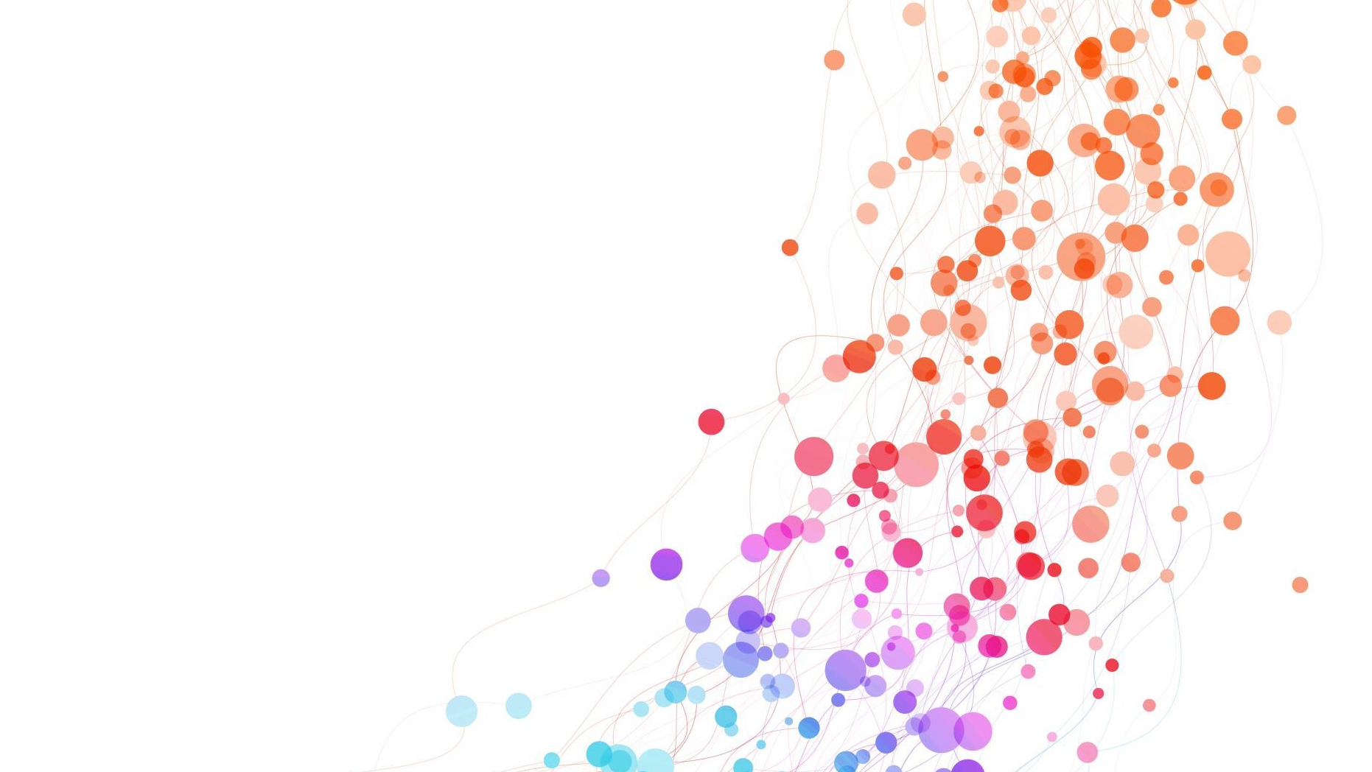
NHANES Data Analysis

Slide 2
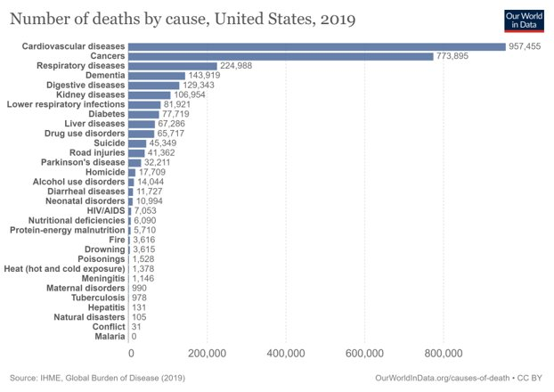
Background
Risk factors for hypertension
Hypertension
Cardiovascular disease

Slide 3
Research Question
1. Which gender is more prone to develop higher systolic pressure in the US?
H0: Male systolic pressure = female systolic pressure
H1: Male systolic pressure ≠ female systolic pressure
2. Do people who drink more regularly have a higher systolic pressure in the US?
H0: Alcohol consumption is not associated with systolic pressure
H1: Alcohol consumption is associated with systolic blood pressure

Slide 4
Methods
Variables
Variables
Outcome: Systolic Pressure
Exposure: Gender
Outcome: Systolic Pressure
Exposure: Alcohol Consumption
Target population
Exclusion criteria
Exclusion criteria
Aim 1
Aim 2
People who are at least 21 years old, not pregnant and do not have diabetes.
<21 years-old
Pregnant women
People with diabetes
<21 years-old
Pregnant women
People with diabetes
Statistical analysis
Statistical analysis
Two sample T-test
Linear Regression
Q-Q plot
Residuals vs. fitted values plot

Slide 5
Characteristics of the Study Population
​ | Overall​ N = 6,232​
Mean age - yr (SD)​ | 46.54 (16.42)​
Female - n (%)​ | 3,152 (50.58)​
Mean BMI - kg/m² (SD)​ | 28.37 (6.26)​
Race - n (%)​ Black​ Hispanic​ Mexican​ White​ Other​ | ​ 656 (10.53)​ 355 (5.70)​ 498 (8.00)​ 4,264 (68.42)​ 459 (7.37)​
​ | Overall​ N = 6,232​
Education - n (%)​ 8th grade 9 – 11th grade High school​ Some college​ College graduated​ | ​ 344 (5.52)​ ​752 (12.07) 1,295 (20.78)​ 1,913 (30.70)​ 1,919 (30.79)​
Marital Status - n (%)​ Married​ Live Partner Divorced​ Never married​ Separated Widowed | ​ 3,436 (55.13)​ 511 (8.20) 603 (9.68)​ 1,164 (18.68)​ 155 (2.49)​ 361 (5.79)
​ | Overall​ N = 6,232
Annual household income $ - n (%)​ < 35k​ 35 - < 45k​ 45 - < 55k 75 - < 10k ≥ 10k​ | ​ ​ 589 (9.45) 533 (8.55)​ 508 (8.15)​ 694 (15.47) 1481 (23.76)

Slide 6
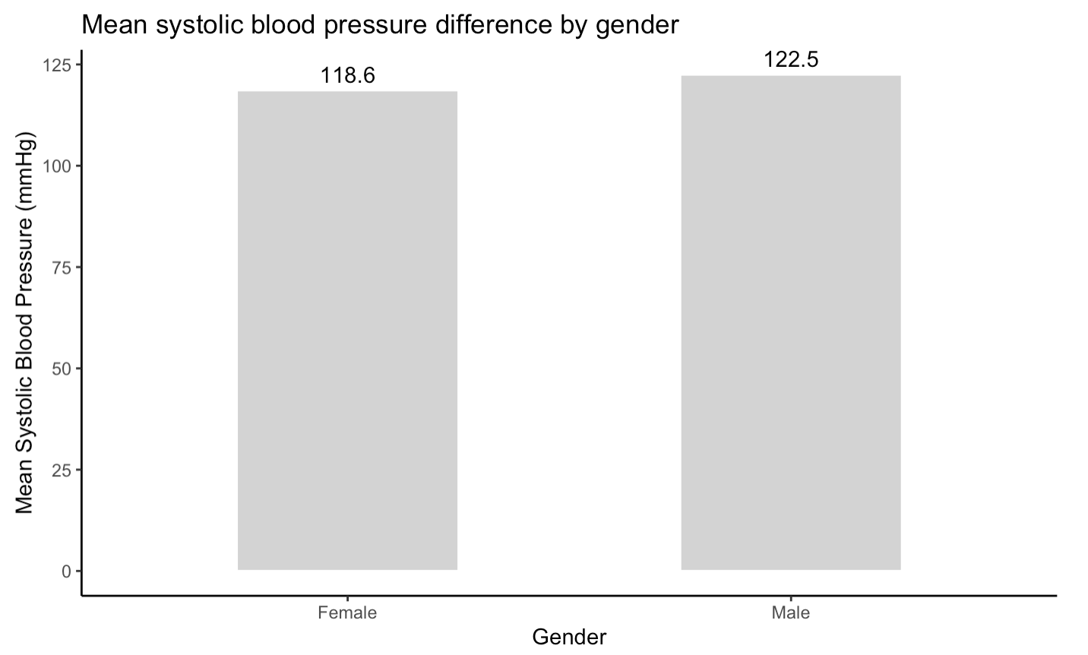
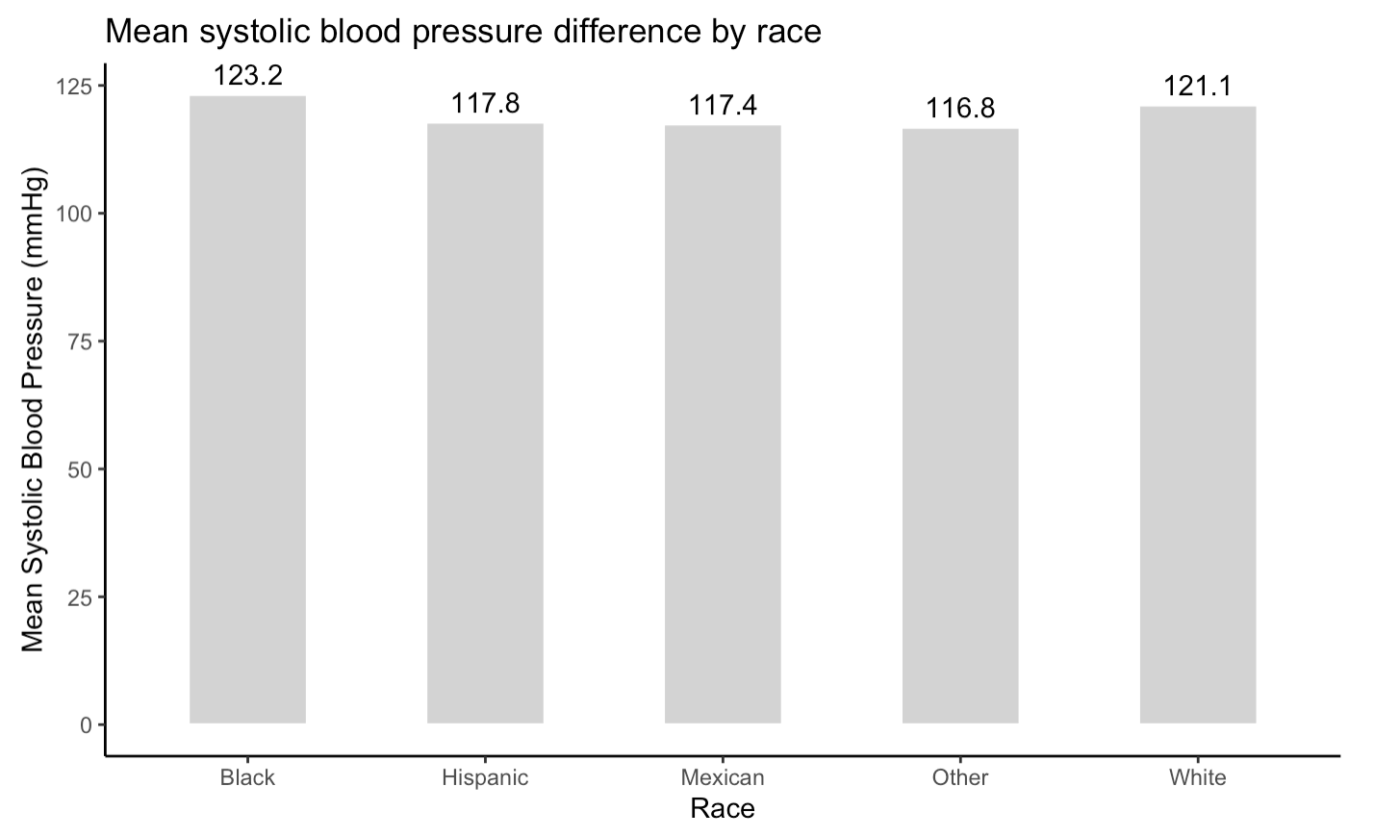
Mean Systolic Blood Pressure in Different Demographic Groups

Slide 7
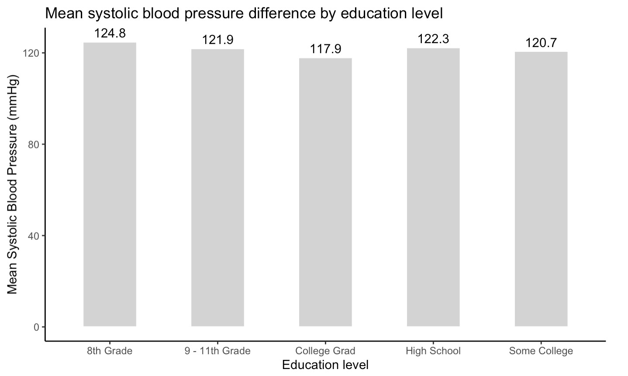
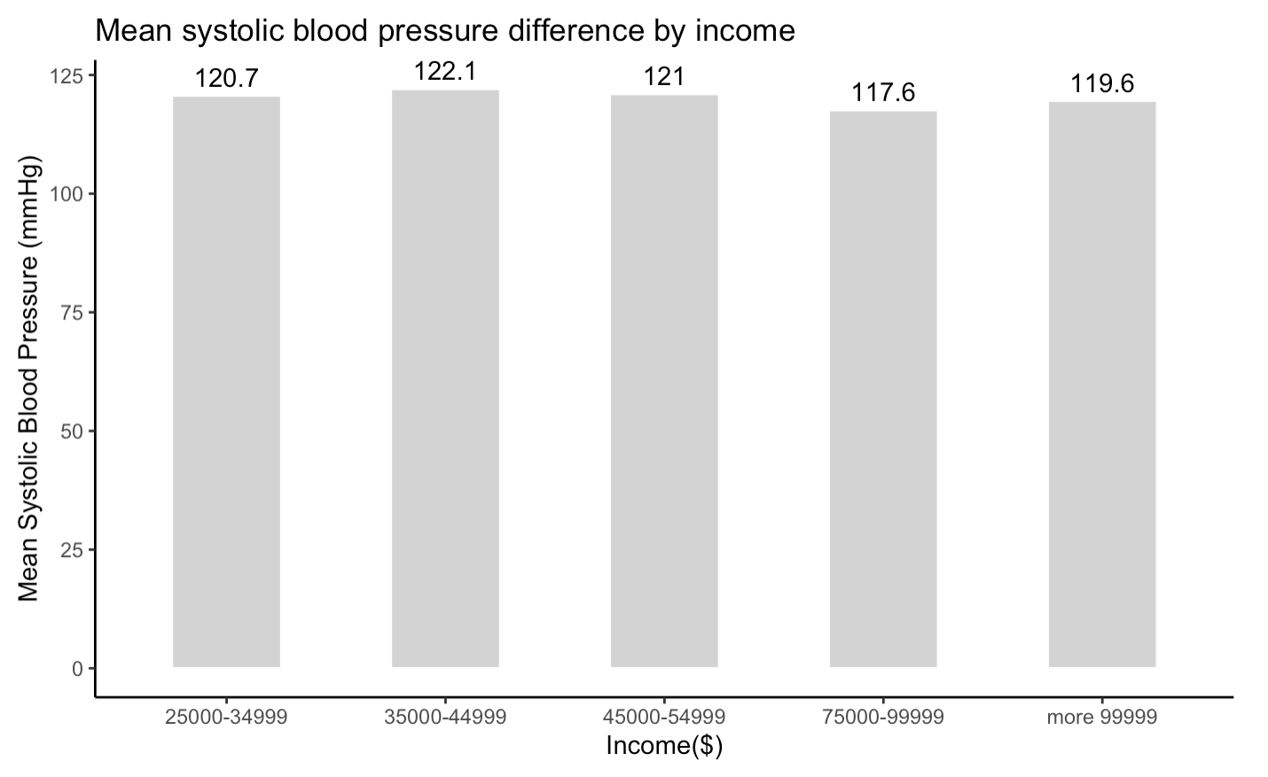
Mean Systolic Blood Pressure in Different Demographic Groups (cont.)

Slide 8
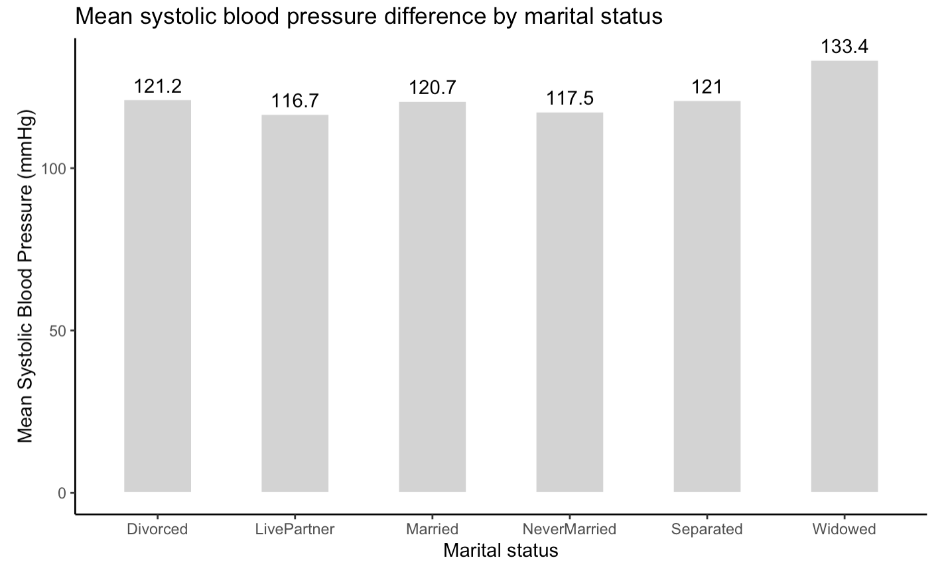
Mean Systolic Blood Pressure in Different Demographic Groups (cont.)

Slide 9
Aim 1: t-test result
Method: welch two sample T-test
Factor: Condition (Male vs. Female)
​ | Mean of male ​ | Mean of female ​ | Mean difference​ | 95% CI | t​ | df​ | P-value​
Systolic pressure​ | 122.495​ | 118.624​ | 3.871​ | 3.029​ - 4.713 | 9.014​ | 5949​ | < 0.05

Slide 10
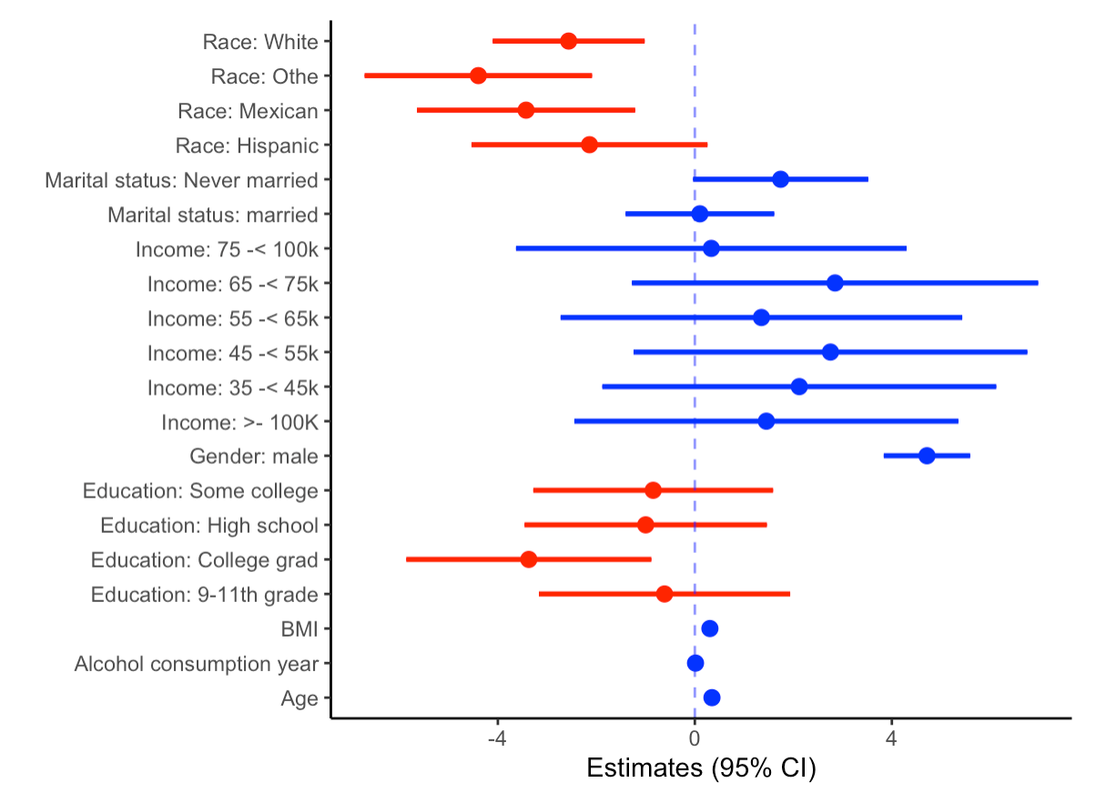
Sensitivity Analysis: Forest plot of the linear regression coefficient estimates
​ ​ | β_{AlcoholYear}​ ​
Value​ | 0.0135
SE​ | 0.002​
95% CI Lower​ | 0.010​
95% CI Upper​ | 0.018​
t​ | 6.295
d.f.​ | 4535
P-value​ | 13.36e-10 ​

Slide 11
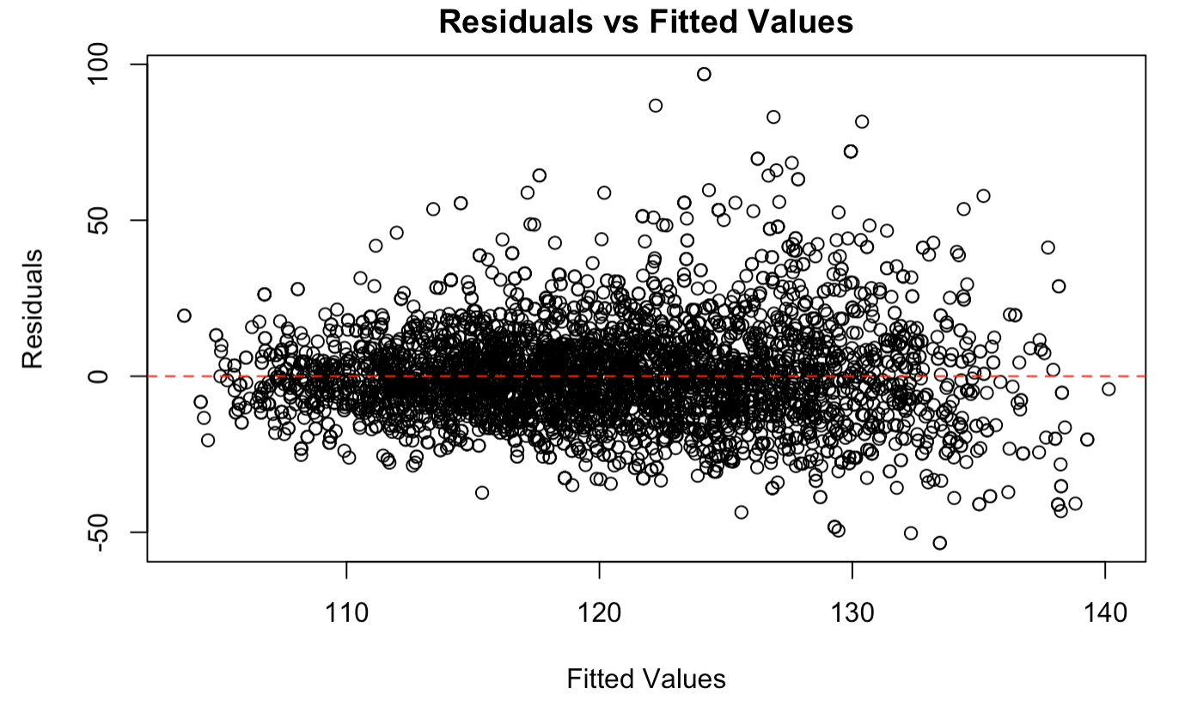

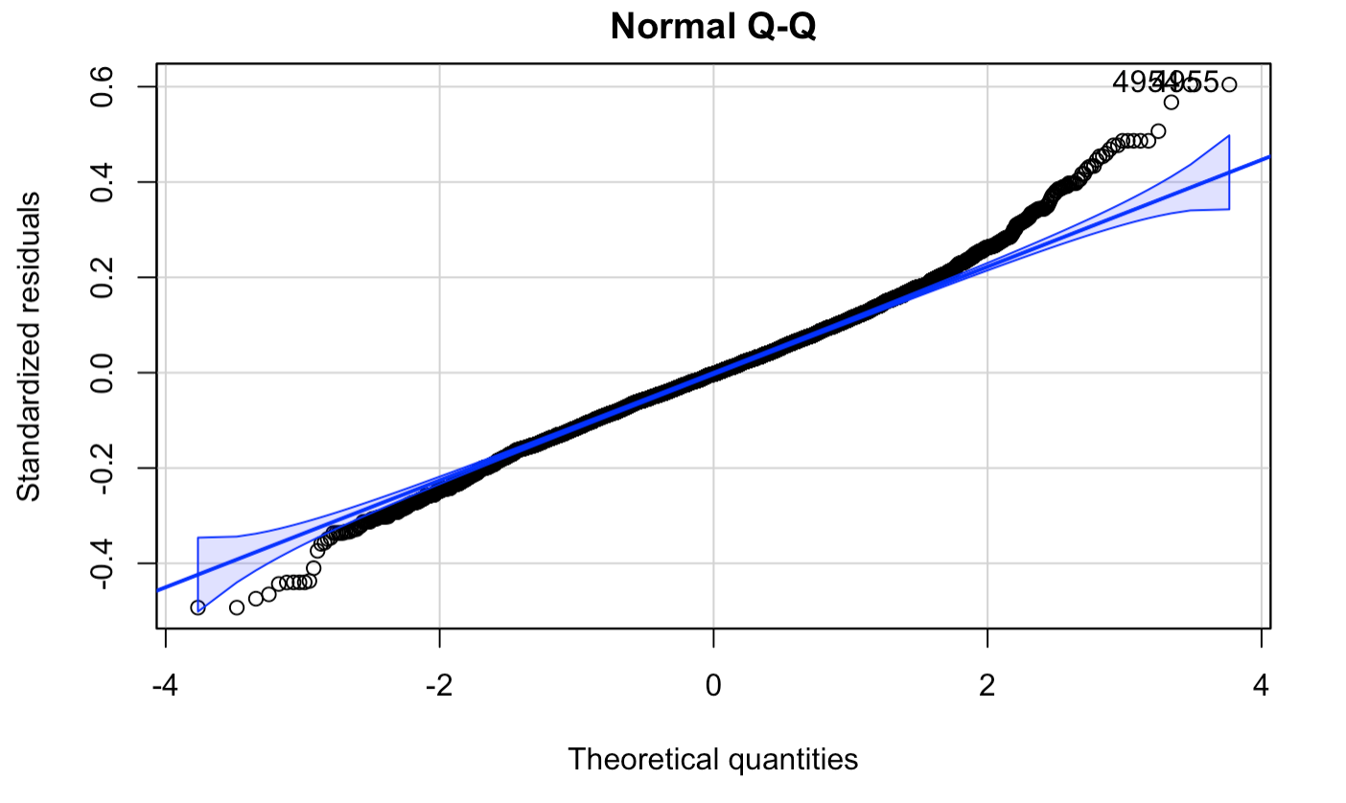
Aim 2: Limitations & Possible Solutions
Limitations:
Slight heteroscedasticity
Non-normal data (positively-skewed)
Solutions:
Log transformation of data
Data normalization – Box-Cox transformation
Polynomial regression

Slide 12





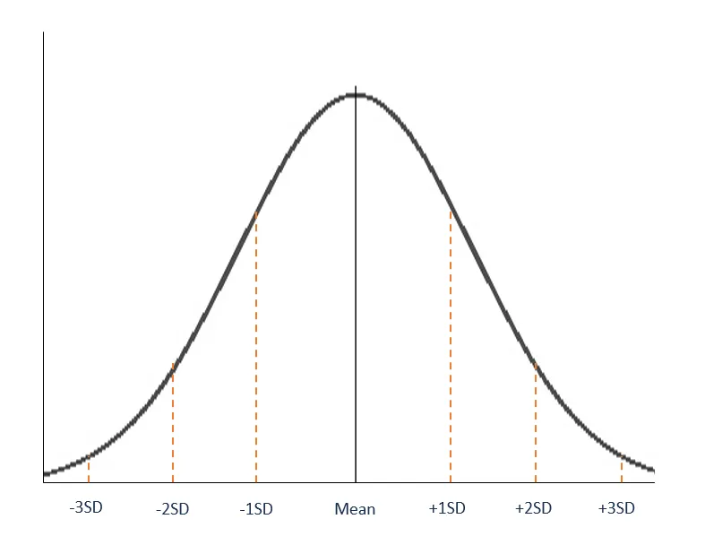

Conclusion
Aim 1:
Systolic blood pressure
Systolic blood pressure
H0: Male systolic pressure = Female systolic pressure
Aim 2:
Significant but small association
Non-normally distributed data
H0: Alcohol consumption is associated with systolic blood pressure.​
H1: Greater alcohol consumption is associated with systolic blood pressure.​

Slide 13
Implications
Further analyses to determine reasons for blood pressure difference between men and women
We should target blood pressure interventions towards populations at higher risk
Additional statistical analysis to study association between alcohol consumption and systolic blood pressure

Slide 14
Appendix

Slide 15
